Slide 1
Introduction to Big Data & Data Science

Slide 2
What’s Big Data?
Big data is the term for a collection of data sets so large and complex that it becomes difficult to process using on-hand database management tools or traditional data processing applications.
The challenges include capture, storage, search, sharing, transfer, analysis, and visualization.
The trend to larger data sets is due to the additional information derivable from analysis of a single large set of related data, as compared to separate smaller sets with the same total amount of data, allowing correlations to be found to "spot business trends, determine quality of research, prevent diseases, link legal citations, combat crime, and determine real-time roadway traffic conditions.”

Slide 3
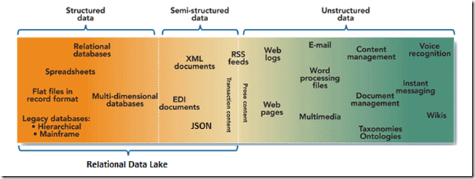
Types of data

Slide 4
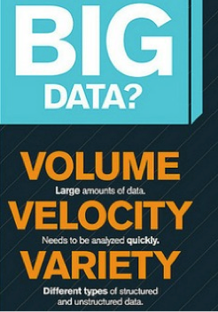

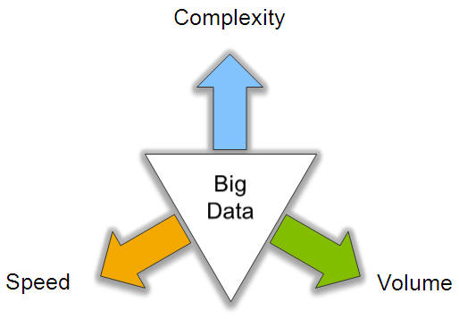
Big Data: 3V’s

Slide 5
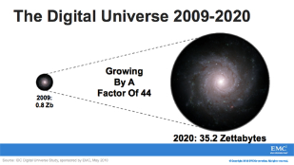
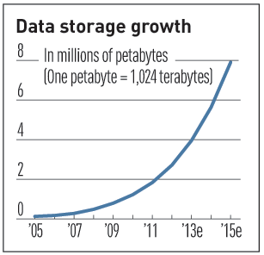

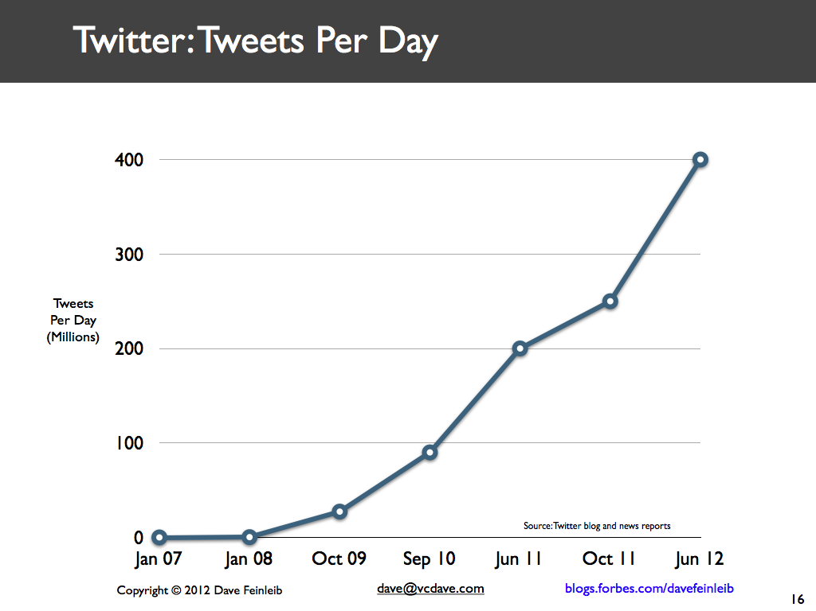
Volume (Scale)
Data Volume
44x increase from 2009 2020
From 0.8 zettabytes to 35zb
Data volume is increasing exponentially
Exponential increase in collected/generated data

Slide 6



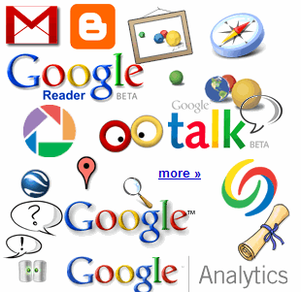

4.6 billion camera phones world wide
30 billion RFID tags today (1.3B in 2005)
12+ TBs of tweet data every day
100s of millions of GPS enabled devices sold annually
? TBs of data every day
25+ TBs of log data every day
2+ billion people on the Web by end 2011
76 million smart meters in 2009… 200M by 2014

Slide 7
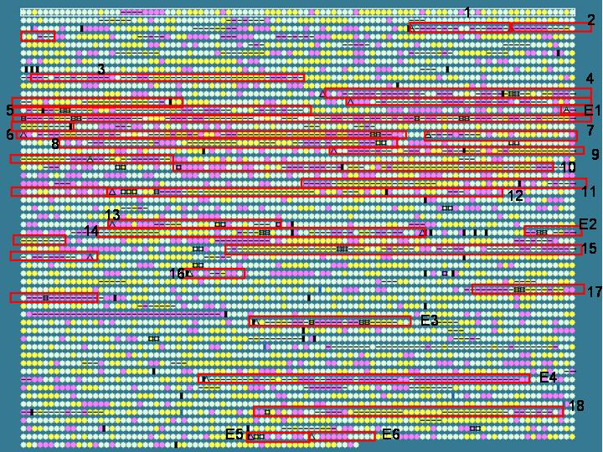
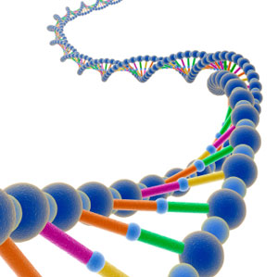
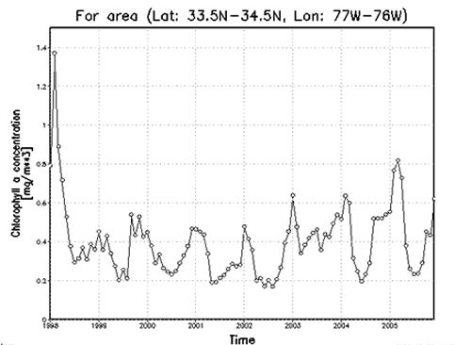

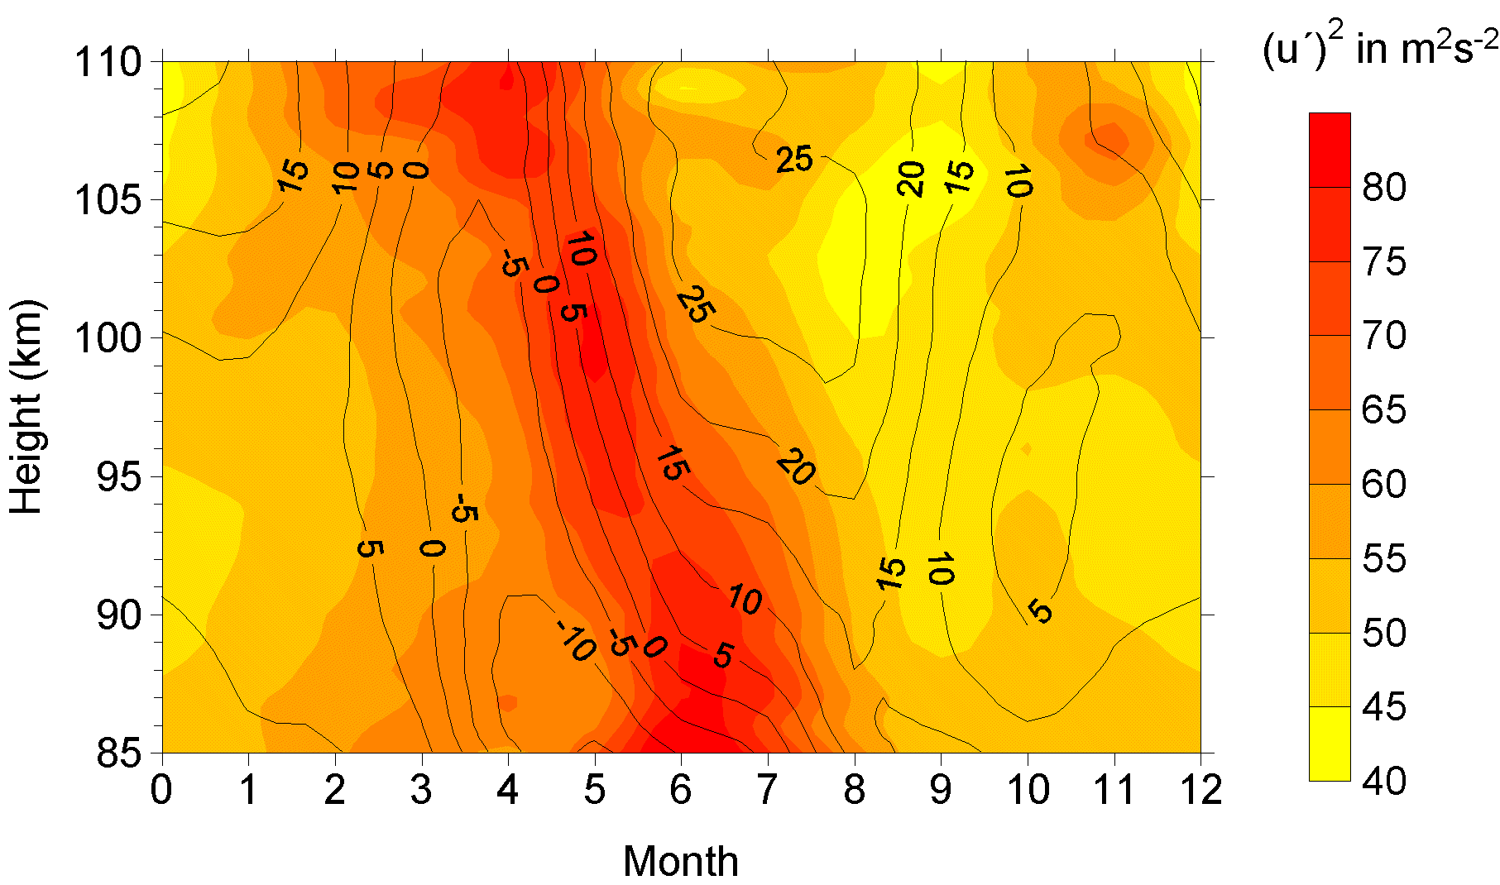
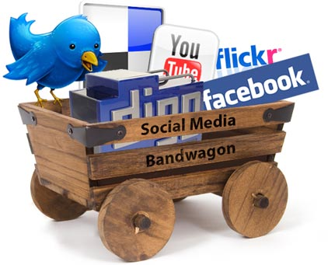
Variety (Complexity)
Relational Data (Tables/Transaction/Legacy Data)
Text Data (Web)
Semi-structured Data (XML)
Graph Data
Social Network, Semantic Web (RDF), …
Streaming Data
You can only scan the data once
A single application can be generating/collecting many types of data
Big Public Data (online, weather, finance, etc)
To extract knowledge➔ all these types of data need to linked together

Slide 8
Big Data Characteristics
Volume: scale at which the data is growing.
Variety: encompasses structured data (customer information), semi-structured (XML), unstructured data (videos, images, sensors)
Velocity: static and dynamic streaming data from business applications
Value: extract additional value from big data sources to provide business insights for better decision making.
Veracity: dependability, trustworthiness, reliability and certainty of data.
Validity: correctness, authenticity, accuracy of data used for extracting useful information
Variability: dynamic evolving behavior of a data source. Eg different coffee blends is variety. Each blend may taste different on different days - variability

Slide 9
Big Data Characteristics
Visualisation: to communicate information clearly and effectively to its intended users eg. Charts and graphs
Viscosity: data velocity relative to the time scale of events. Gives time lag between the occurrence and usage of an event. Only highly viscous data is stored; less viscous data calls for quick action.
Virality: information dispersion/ spread in a people-to-people network
Volatality: a measure of the rate of loss/stability of data. Time for validity and storage of data
Venue: source of data and methods to obtain it
Vocabulary: data models and data structures used to organize, store, and analyse data
Versatality: data used differently under different contexts

Slide 10
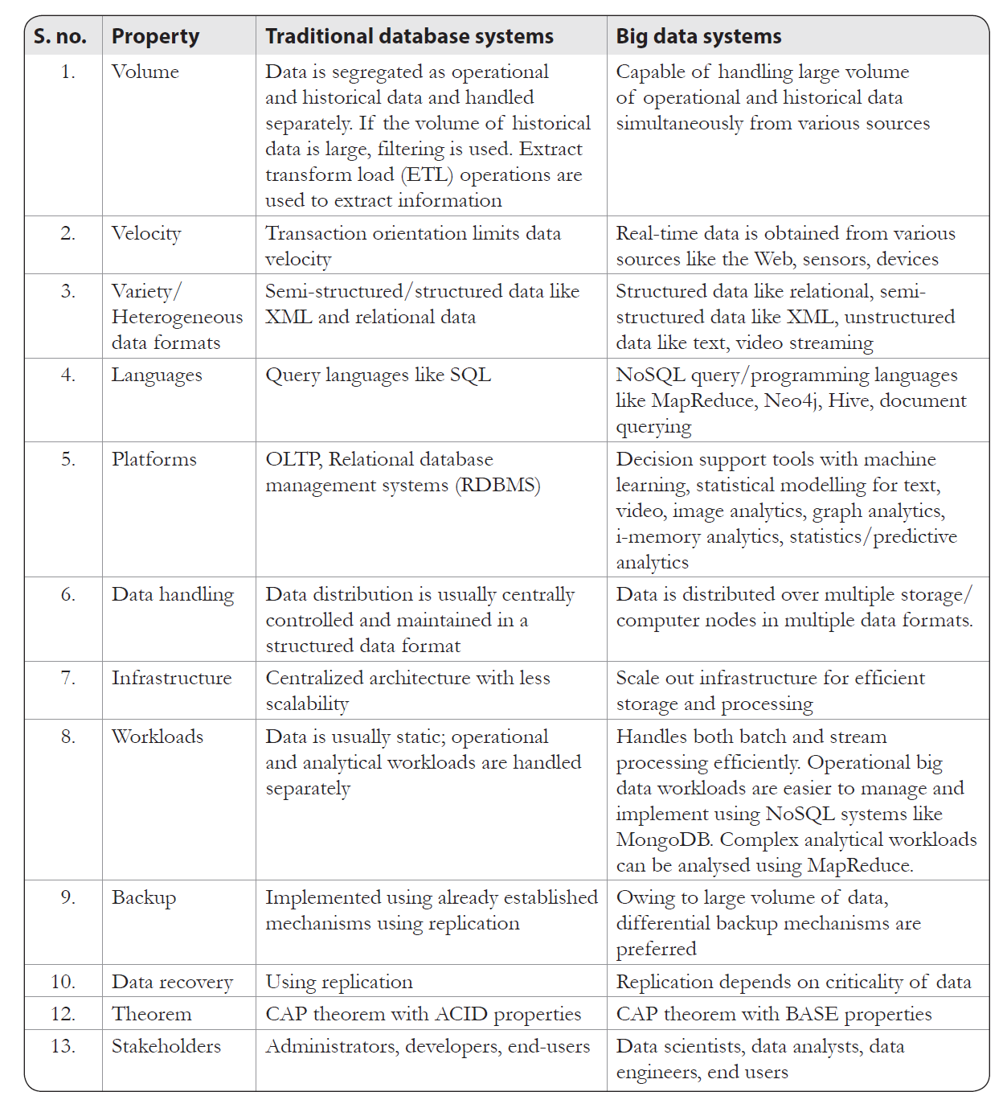
Traditional vs Big Data Systems

Slide 11
Traditional vs Big Data Systems
Processing – transactional vs analytical
Framework – structured vs heterogeneous data
Infrastructure - small/medium scale with centralized control vs large scale

Slide 12
Roles in Data Science Team
Data scientist designs and conducts expt. By collecting and cleansing, analysing data, inferring insights & visualizing the results
Statistician: collects, analyses, and interprets data using statistical methods to transform businesses.
Data analyst: collects, processes, and analyses data. Unlike data scientist, he does not invent new algorithms
Business analyst: aims at improving the business from the insights
Data Architect: creates a blue print for the data management system to capture, integrate, organize, protect, and maintain data
Database Administrator: manages and maintains the database
Data Engineer: has SE skills to develop, construct, test, and maintain frameworks
Data Architect
Design new Data models
Design / Impl
storage solutions / models
Data mungling
Research
Data analysis
Data Scientist
Statistics
Tool usage
Machine learning
Data
Analyst
Mathematics
Visualisation
Manage storage solutions
Design new algorithms
Business insights
DBA
communication
Tool usage
Data Engineer
improve business process
Business Analyst

Slide 13

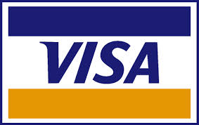















A Single View to the Customer
Social Media
Banking
Finance
Gaming
Our
Known
History
Customer
Entertain
Purchase

Slide 14

Velocity (Speed)
Data is begin generated fast and need to be processed fast
Online Data Analytics
Late decisions ➔ missing opportunities
Examples
E-Promotions: Based on your current location, your purchase history, what you like ➔ send promotions right now for store next to you
Healthcare monitoring: sensors monitoring your activities and body ➔ any abnormal measurements require immediate reaction

Slide 15
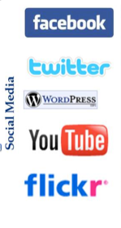
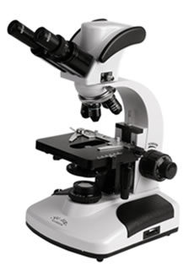

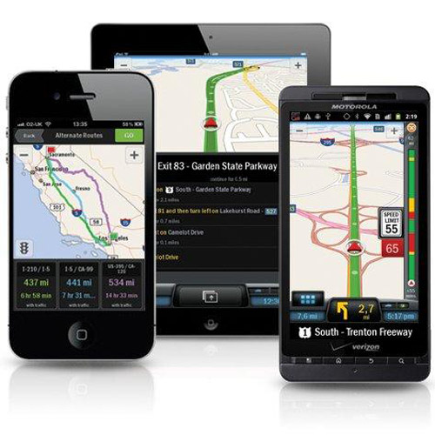
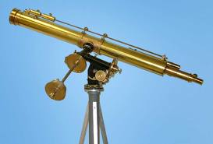
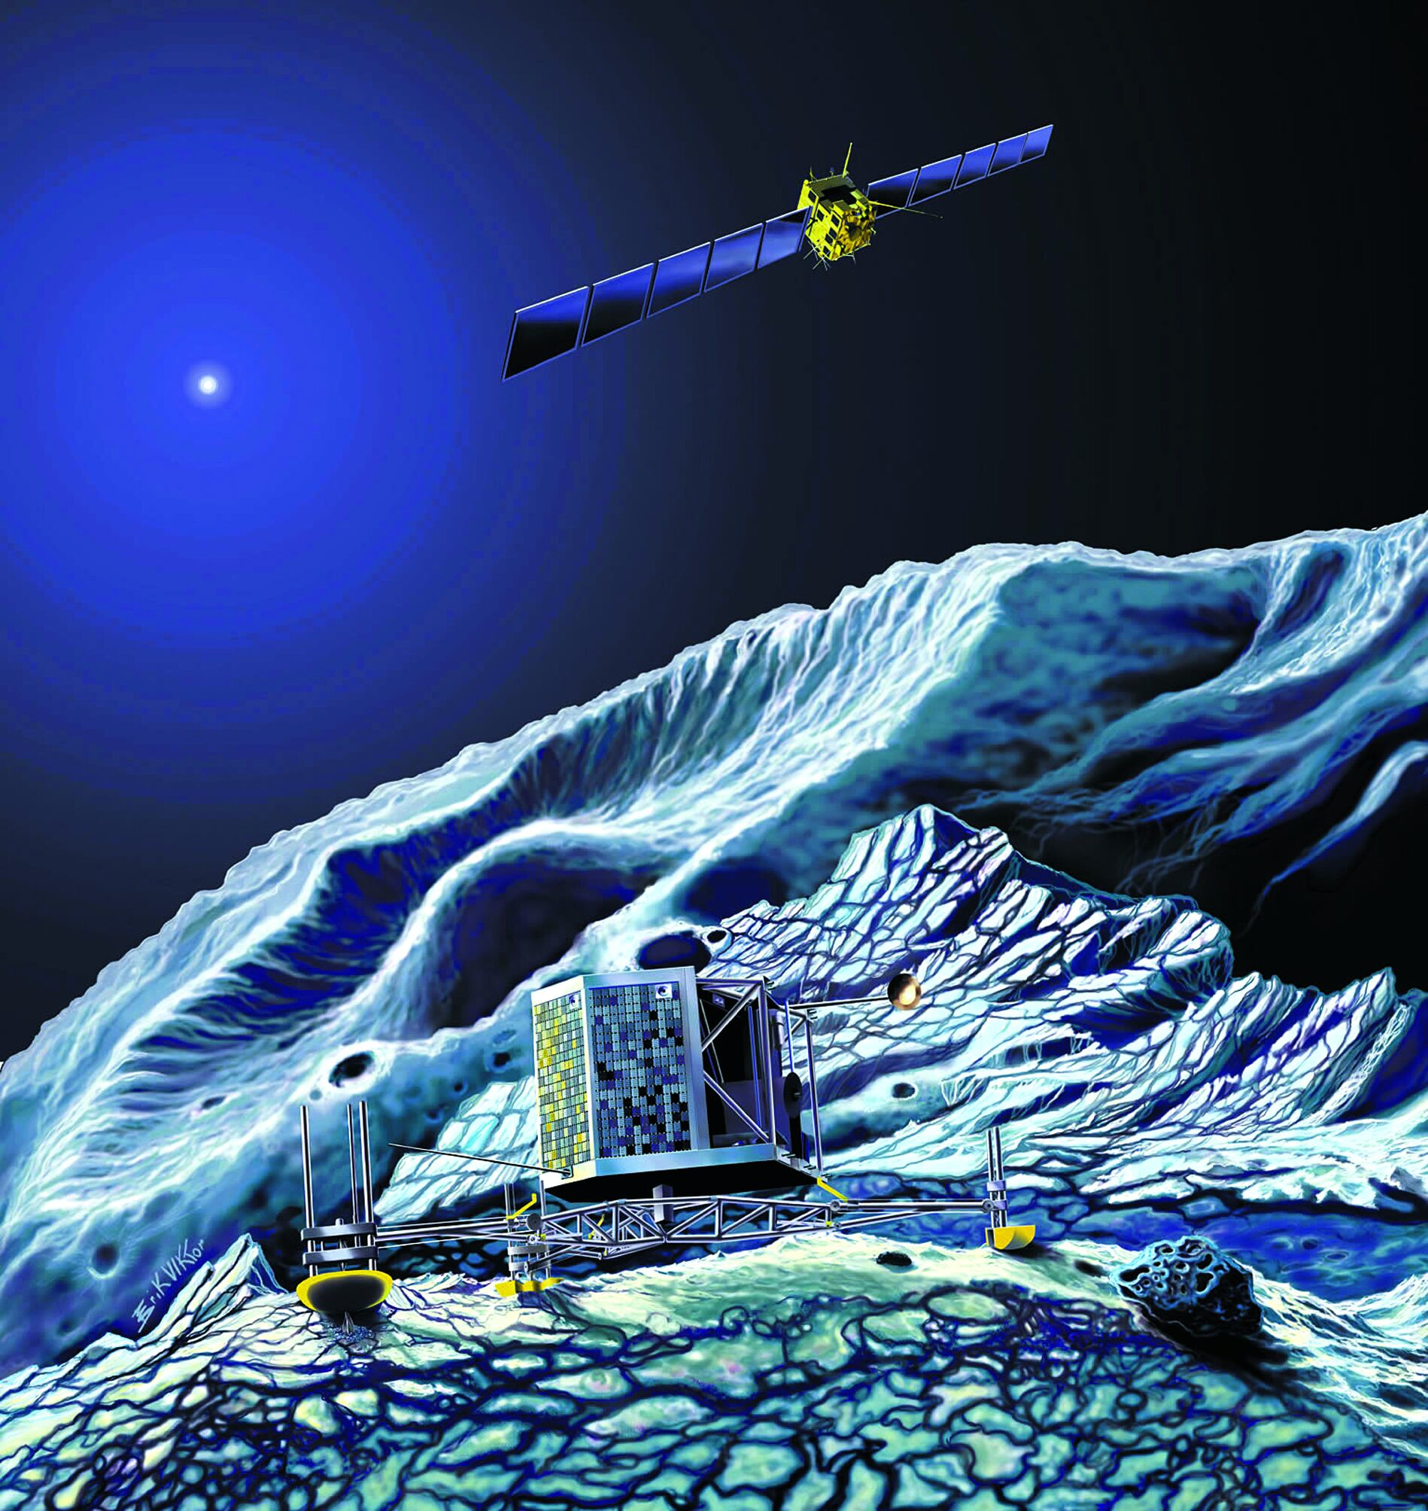
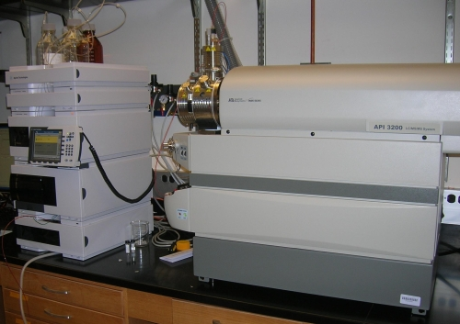
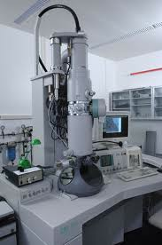
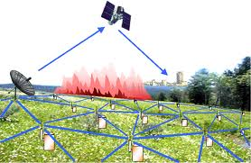
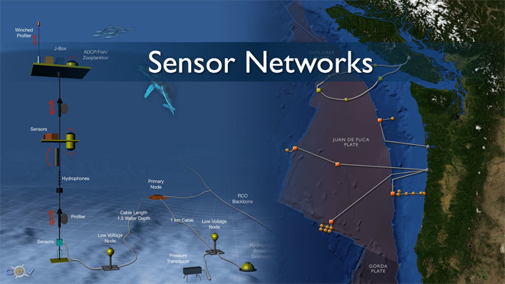
Real-time/Fast Data
Mobile devices
(tracking all objects all the time)
Social media and networks
(all of us are generating data)
Scientific instruments
(collecting all sorts of data)
Sensor technology and networks
(measuring all kinds of data)
The progress and innovation is no longer hindered by the ability to collect data
But, by the ability to manage, analyze, summarize, visualize, and discover knowledge from the collected data in a timely manner and in a scalable fashion

Slide 16
Real-Time Analytics/Decision Requirement
Product
Recommendations
that are Relevant
& Compelling
Learning why Customers
Switch to competitors
and their offers; in
time to Counter
Influence
Behavior
Customer
Friend Invitations
to join a
Game or Activity
that expands
business
Improving the
Marketing
Effectiveness of a
Promotion while it
is still in Play
Preventing Fraud
as it is Occurring
& preventing more
proactively

Slide 17
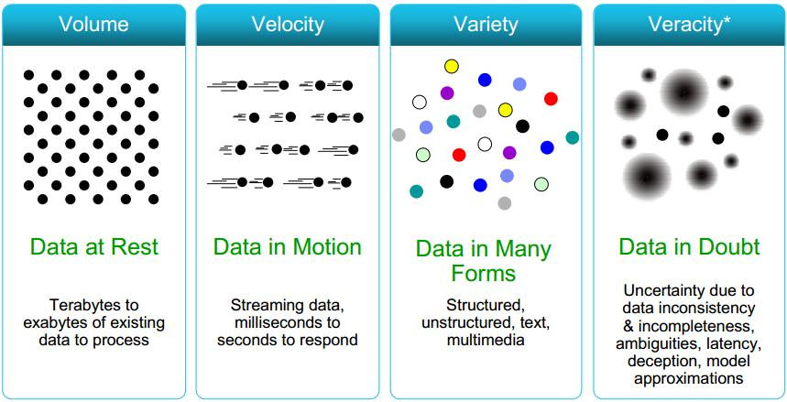
Some Make it 4V’s

Slide 18
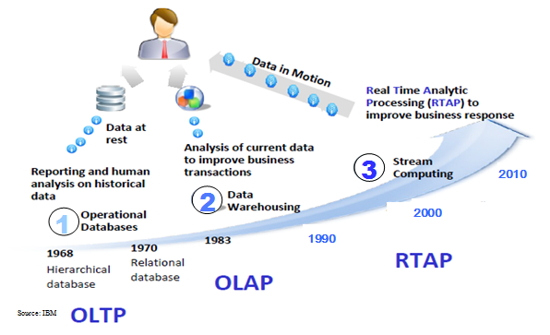
Harnessing Big Data
OLTP: Online Transaction Processing (DBMSs)
OLAP: Online Analytical Processing (Data Warehousing)
RTAP: Real-Time Analytics Processing (Big Data Architecture & technology)

Slide 19
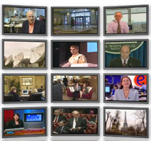

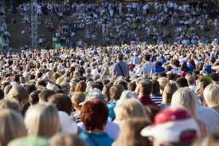

The Model Has Changed…
The Model of Generating/Consuming Data has Changed
Old Model: Few companies are generating data, all others are consuming data
New Model: all of us are generating data, and all of us are consuming data

Slide 20
7 KEY DRIVERS BEHIND THE BIG DATA MARKET
Business
Opportunity to enable innovative new business models
Potential for new insights that drive competitive advantage
Technical
Data collected and stored continues to grow exponentially
Data is increasingly everywhere and in many formats
Traditional solutions are failing under new requirements
Financial
Cost of data systems, as a percentage of IT spend, continues to grow
Cost advantages of commodity hardware & open source software
Source: http://hortonworks.com/blog/7-key-drivers-for-the-big-data-market/

Slide 21
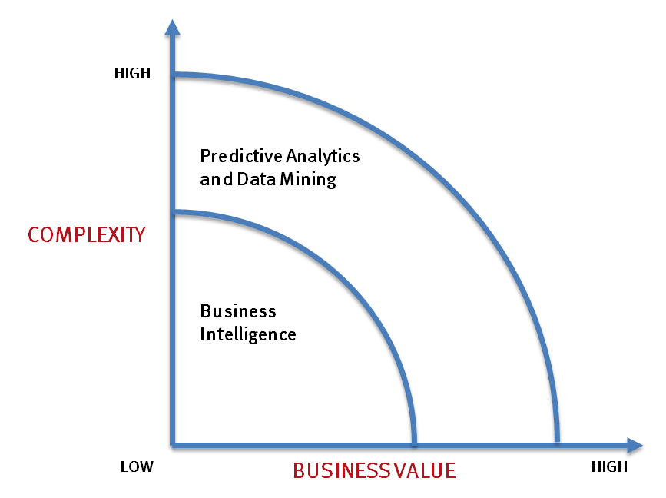
What’s driving Big Data
- Optimizations and predictive analytics
- Complex statistical analysis
- All types of data, and many sources
- Very large datasets
- More of a real-time
- Ad-hoc querying and reporting
- Data mining techniques
- Structured data, typical sources
- Small to mid-size datasets

Slide 22
The Evolution of Business Intelligence
Interactive Business Intelligence &
In-memory RDBMS
QliqView, Tableau, HANA
Big Data:
Real Time &
Single View
Graph Databases
Speed
Scale
BI Reporting
OLAP &
Dataware house
Business Objects, SAS, Informatica, Cognos other SQL Reporting Tools
Big Data:
Batch Processing &
Distributed Data Store
Hadoop/Spark; HBase/Cassandra
Scale
Speed
1990’s
2000’s
2010’s

Slide 23
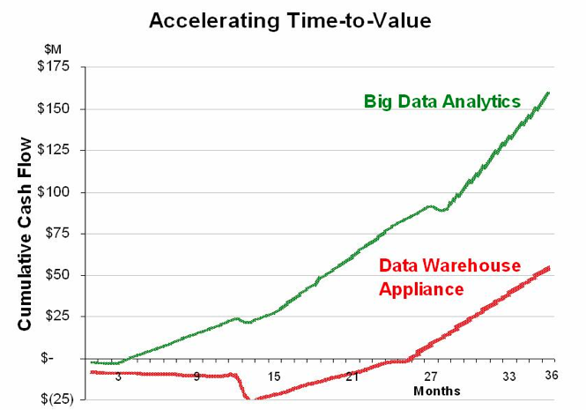
Big Data Analytics
Big data is more real-time in nature than traditional DW applications
Traditional DW architectures (e.g. Teradata) are not well-suited for big data apps
Shared nothing, massively parallel processing, scale out architectures are well-suited for big data apps

Slide 24
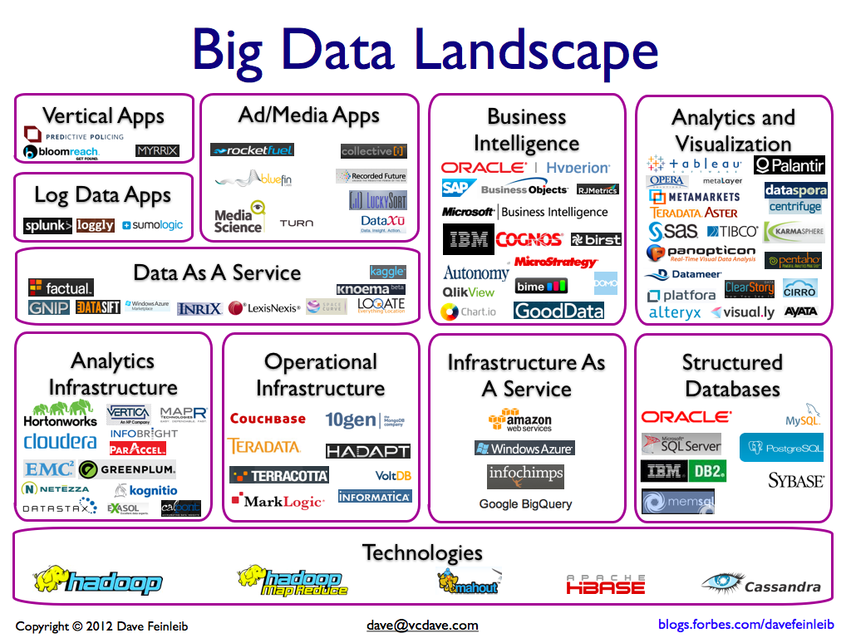

Slide 25
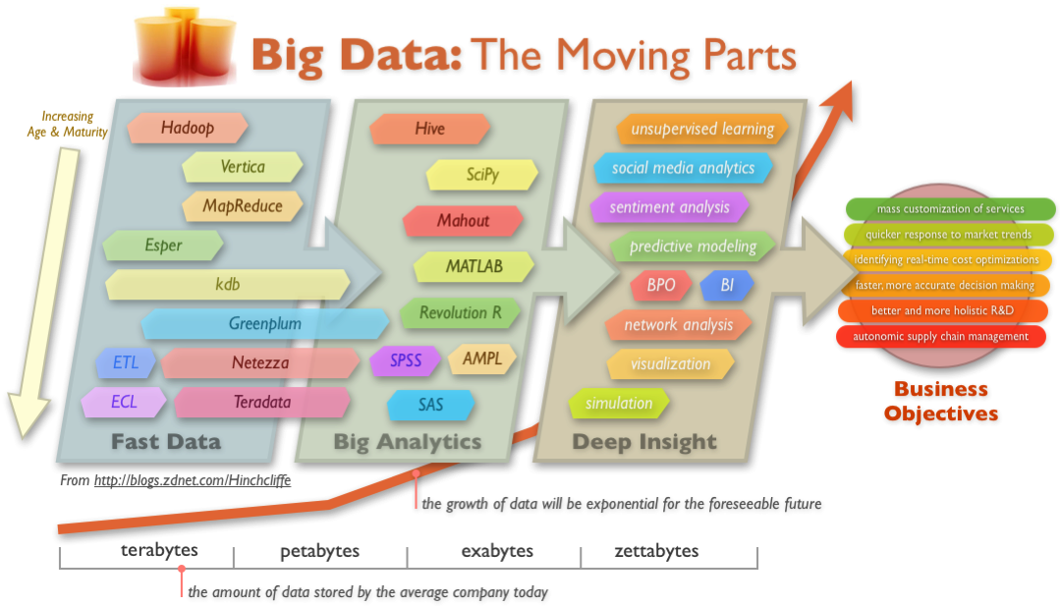
Big Data Technology

Slide 26
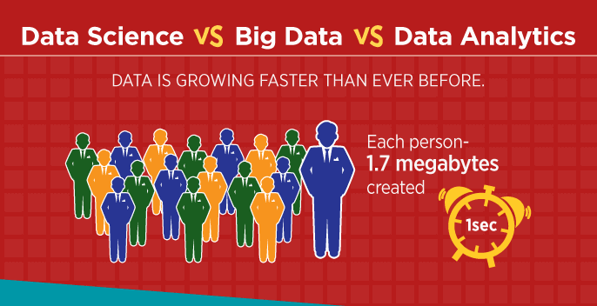

Slide 27
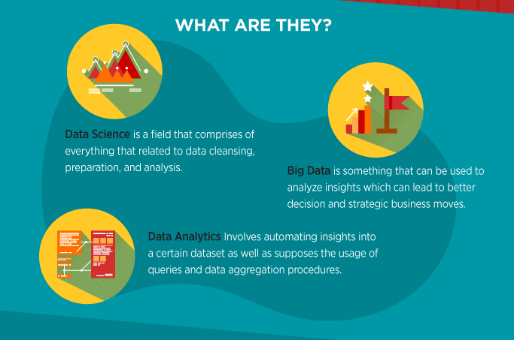

Slide 28
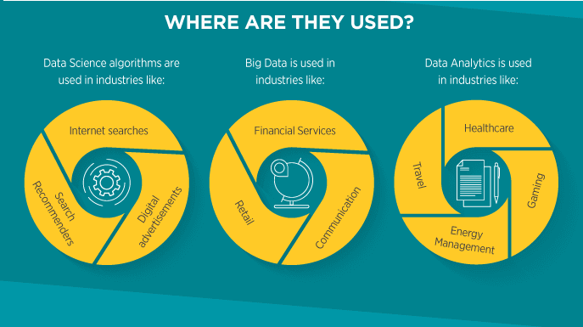

Slide 29
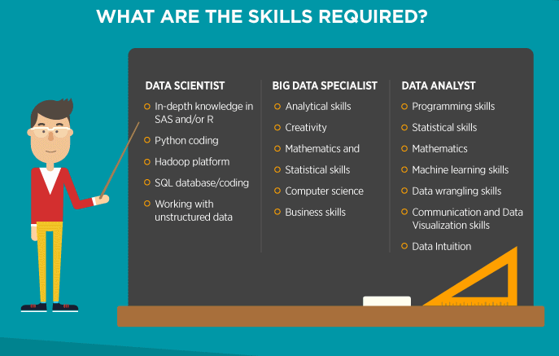

Slide 30
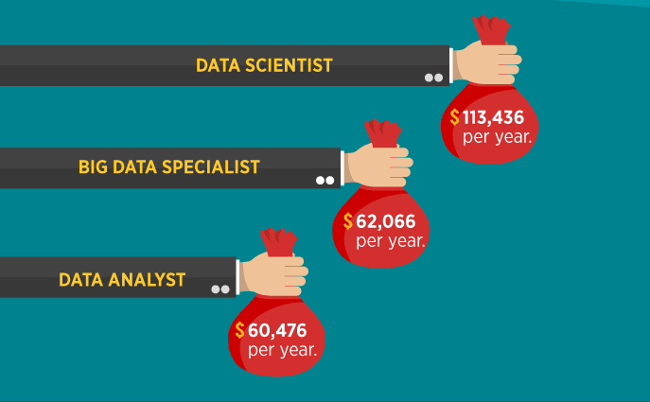

Slide 31
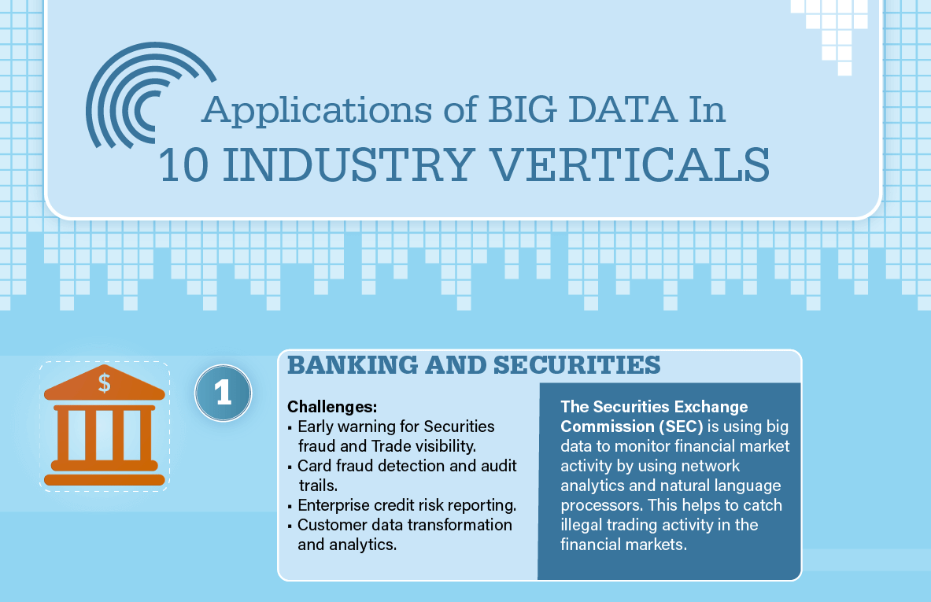

Slide 32
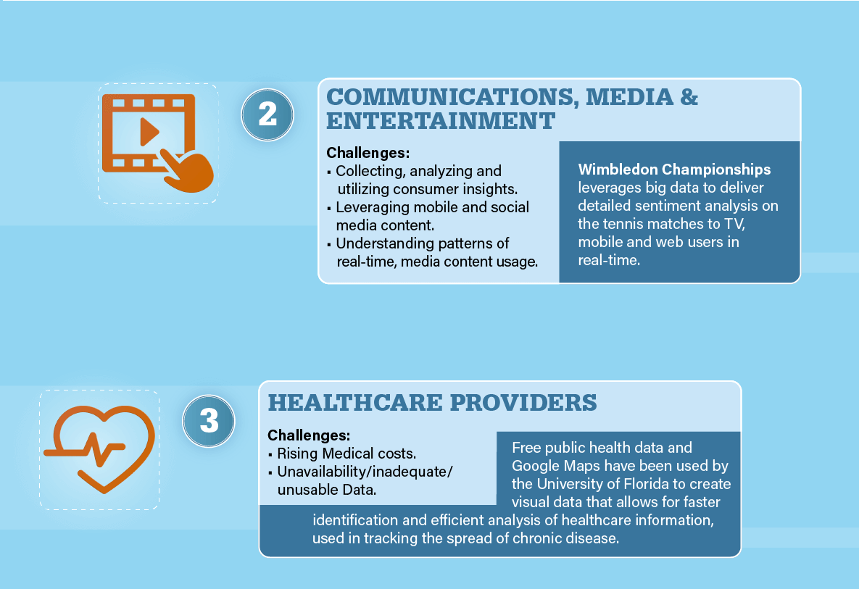

Slide 33
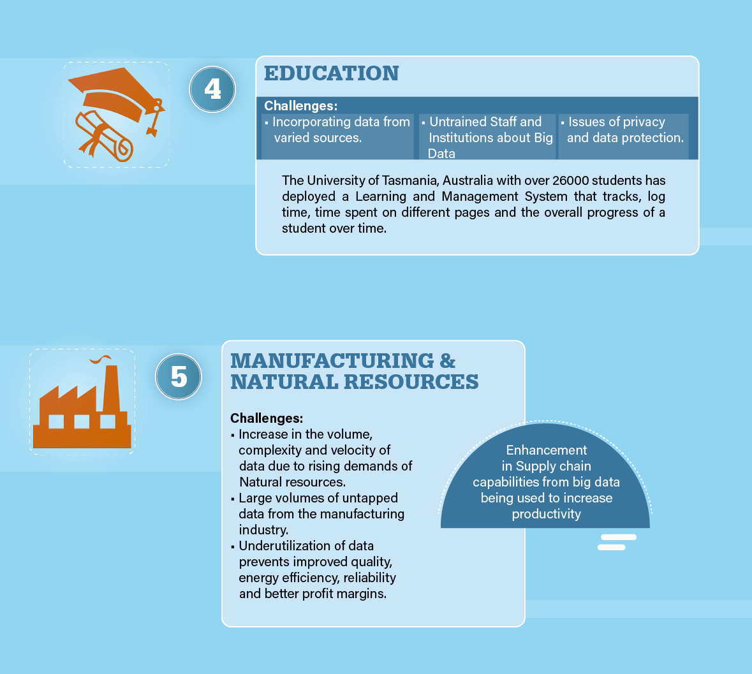

Slide 34
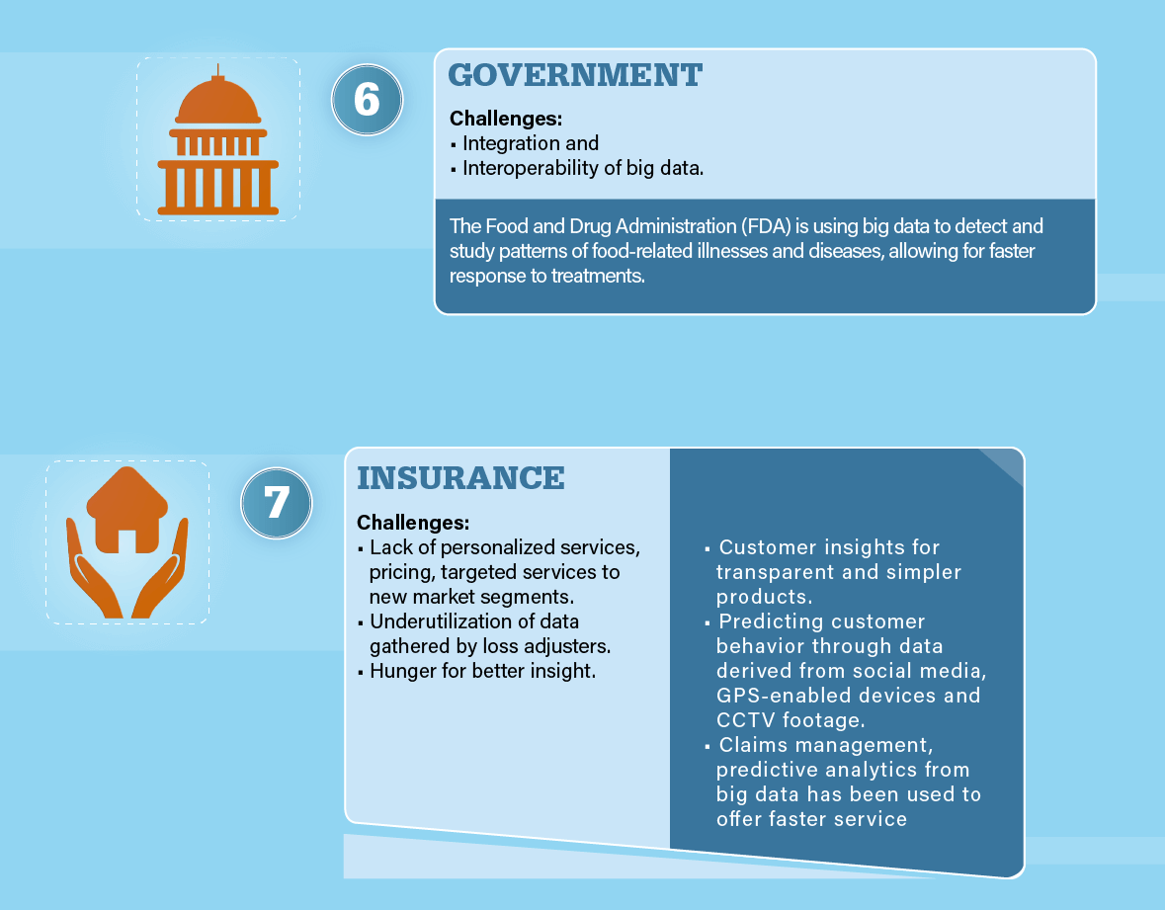

Slide 35
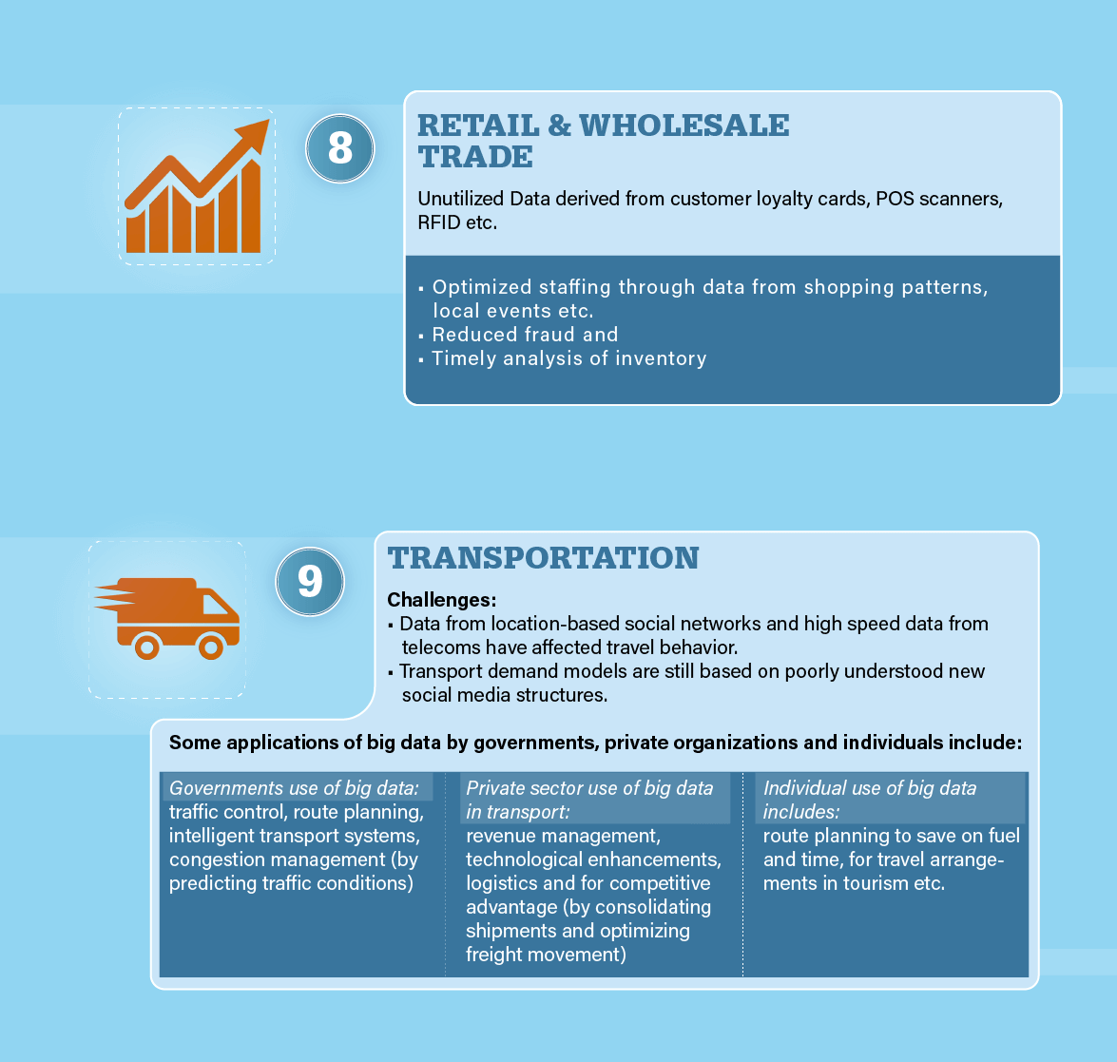

Slide 36
